Slide 1

Environmental Monitoring in Industry: Leveraging AI and IoT for Sustainable Solutions
Group 1
Muyombano Happy Axel
Uwanyagasani Jerome
Nikuze Charlotte
Grace
Patrick
Donatha
Emmanuel

Slide 2
Introduction
IoT tools were utilized to monitor environmental purity
Over 1000 entries of data was collected
Data was collected in 2 different environments
Worldwide over 1.6 million deaths are attributed to indoor pollution. Ritchie, H., and M. Roser. 2022

Slide 3
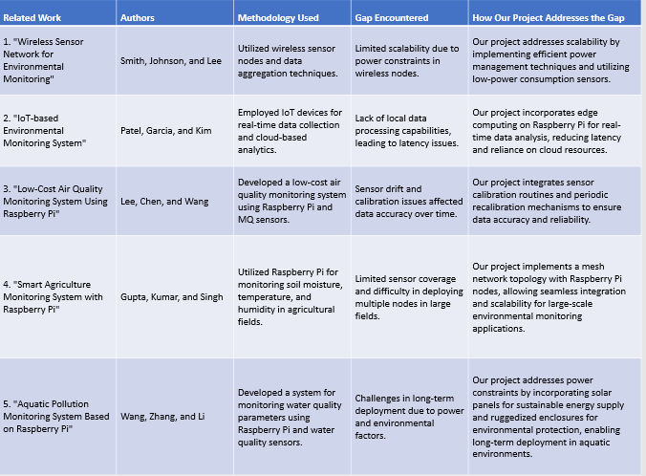
Related works

Slide 4
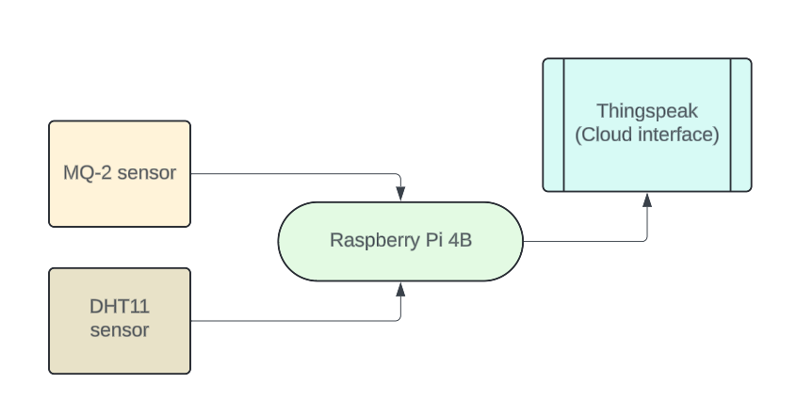
Methodology

Slide 5
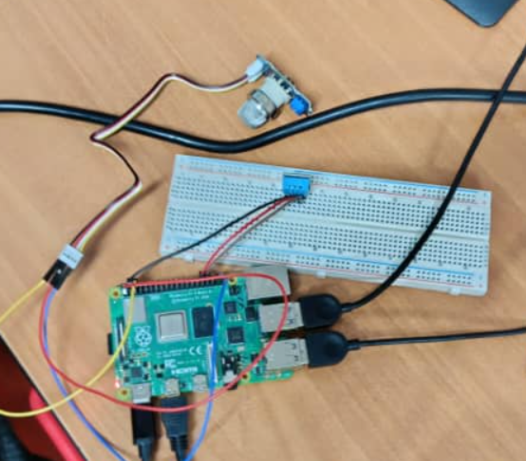
Hardware prototype

Slide 6
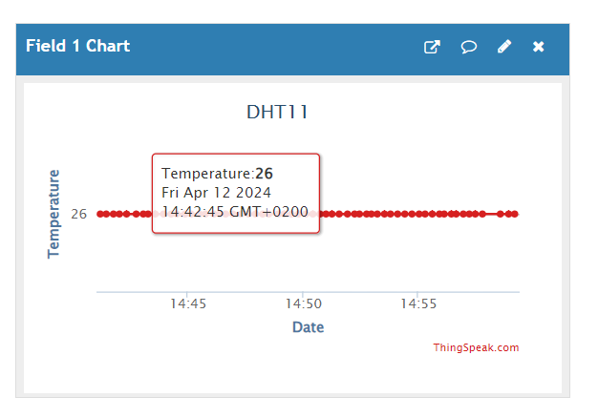
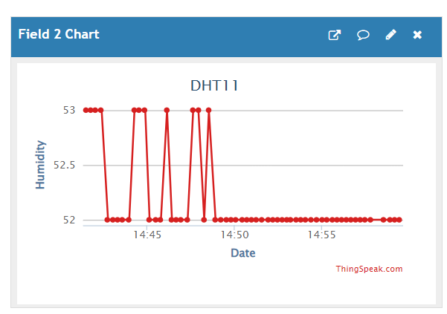
Results and data analysis
Temperature results
Humidity results

Slide 7
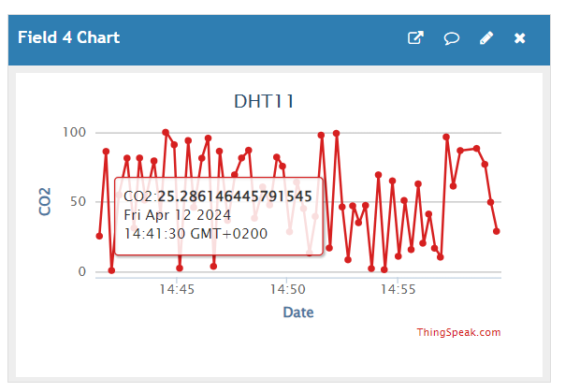
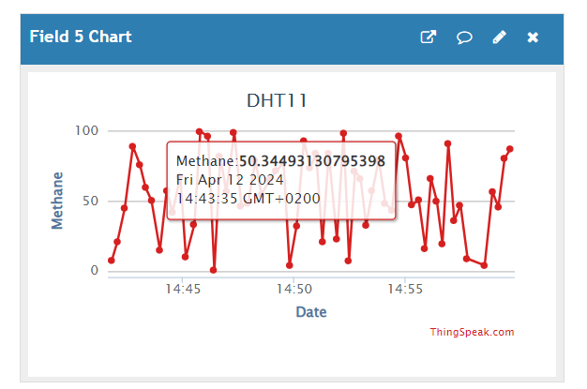
Results and data analysis
CO2 results
Methane results

Slide 8
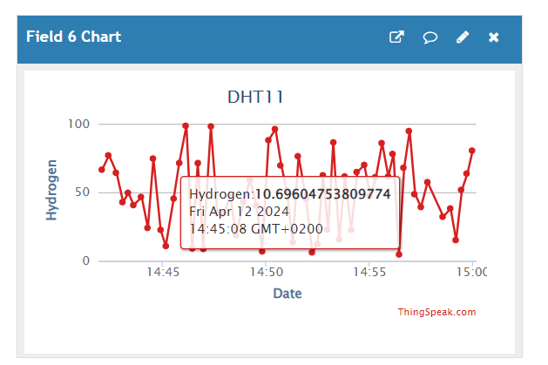
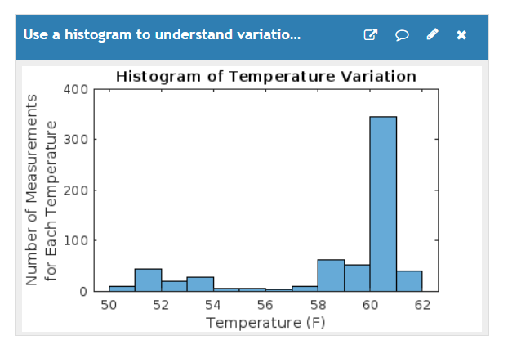
Results and data analysis
Hydrogen results
Temperature variations

Slide 9
Statistical evaluation
Parameter | Measurements
 | Mean | Standard deviation | Range
CO2 (ppm) | 48.57 | 28.79 | 99.26
Temperature (°C) | 24.60 | 1.06 | 19
Humidity (g/m3) | 59.29 | 3.65 | 23
Methane | 50.23 | 29.97 | 99.6
Hydrogen (nm) | 51.33 | 28.98 | 99.36

